Slide 1
CTF Group: OSINT
Information is everywhere, so how does one find it?

Slide 2
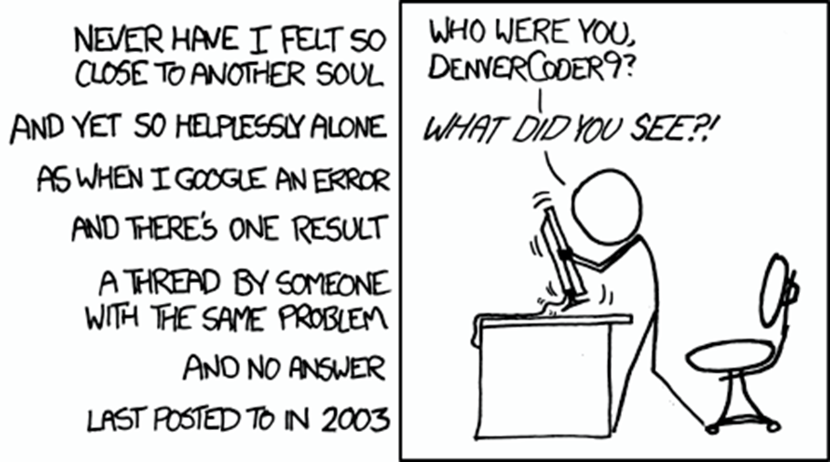
Quick Overview of Today’s Meeting:
What is OSINT?
Tools in OSINT
Strategies to improve skills
OSINT in CTF’s

Slide 3
OSINT : Open Source INTelligience A methodology for collecting, analyzing and making decisions based on data accessible through publicly available sources. Why do we care? - Information is power. It is difficult to approach any problem with incomplete information, or a lack of information. Especially in Cybersecurity. Where is it used? - In social engineering, to build pretext, - In Pen Testing to identify possible vectors, - In problem solving in general, because it’s highly likely someone else has faced a similar problem beforehand

Slide 4
Biggest takeaway from today: Information that is accessible is information that is actionable. OSINT is the practice of finding and accessing information to later use in some future task.

Slide 5
TOOLS:
Collections of tools
OSINT Frameworks
https://osintframework.com/
DNS Dumpster
https://dnsdumpster.com/
OSINT Dojo
https://www.osintdojo.com/resources/
SubDomain Tool https://github.com/aboul3la/Sublist3r
Wayback Machine

Slide 6
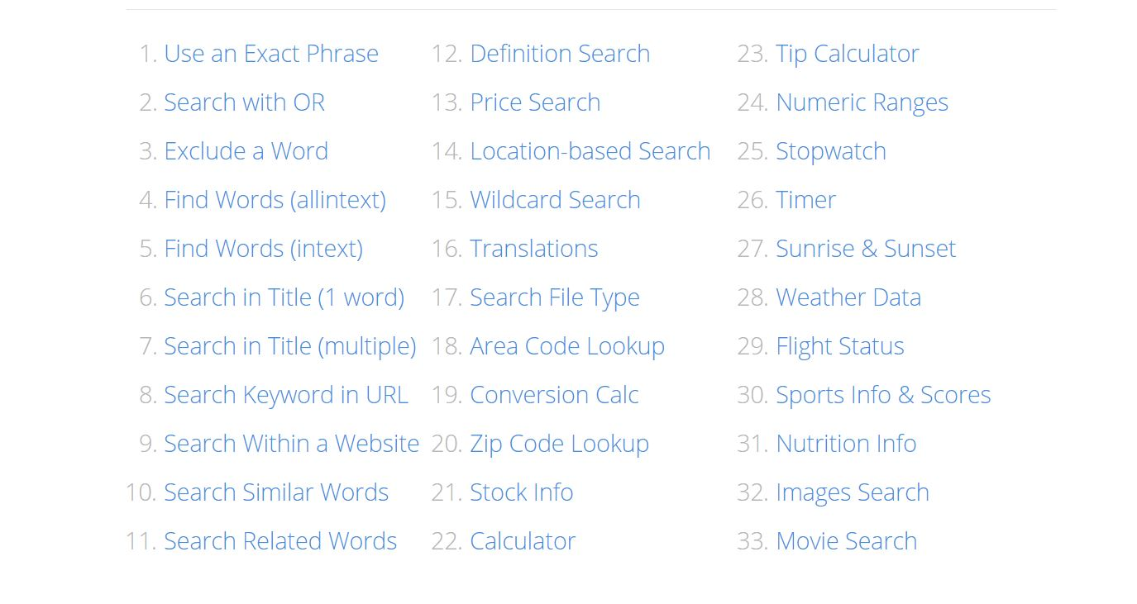
Strategies to improve search skills:
Improve how we “google”
https://www.coforge.com/blog/advanced-google-search-tips

Slide 7
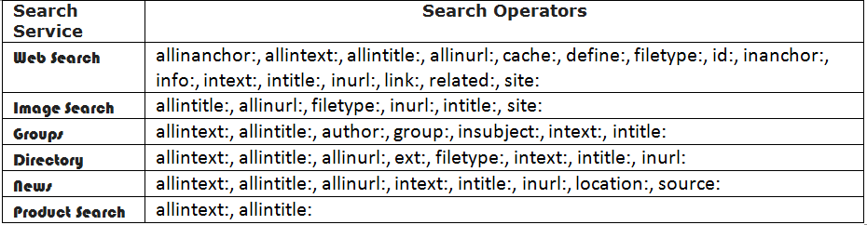

Slide 8
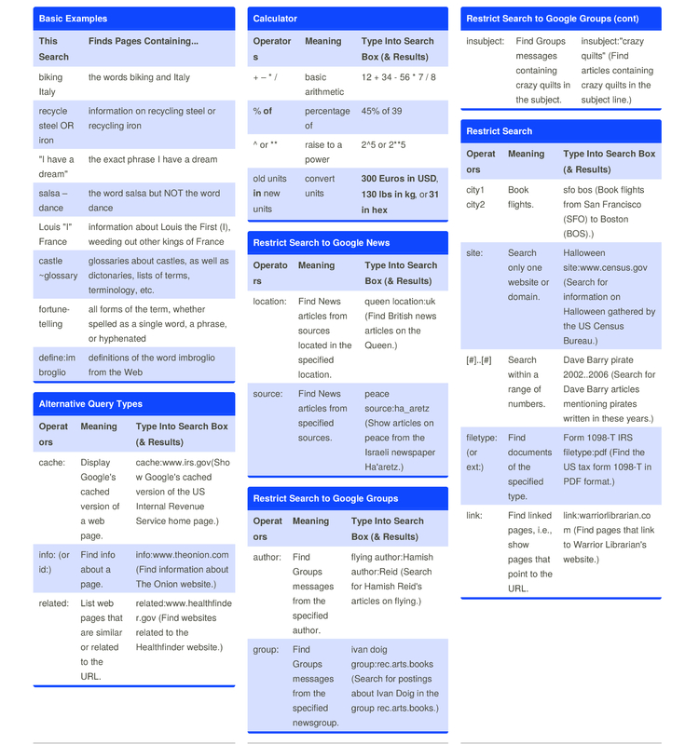

Slide 9
OSINT in CTFS
Well.. To be fair, all CTF problems require some OSINT to some degree or another.
Given a file, problem or direction, the first step in CTF’s is gathering information!
Lots of Common OSINT CTF Challenges:
Specific to the CTF (Umass, BYU)
GeoLocation/Information
Wayback/Domain & other Web MetaData
These types of challenges tend to be more in smaller, localized CTFs such as one hosted by a University
“Everything is OSINT if you try hard enough”
– Liam Brookhart

Slide 10
Let’s try it out/Demo More
Pick something to search and compare what the search results return: justinapplegate.me Try file type, inclusive words or exclusive of words Check out: https://github.com/cipher387/osint_stuff_tool_collection

